Slide 1

Introduction to Entrepreneurship
Dr. Zunaira Saqib

Slide 2

Week 7: Defining Target Market and Customer Personas
Understanding target market for your startup
Describing customers persona

Slide 3

Unique Selling Proposition
What makes you unique and competitive?

Slide 4
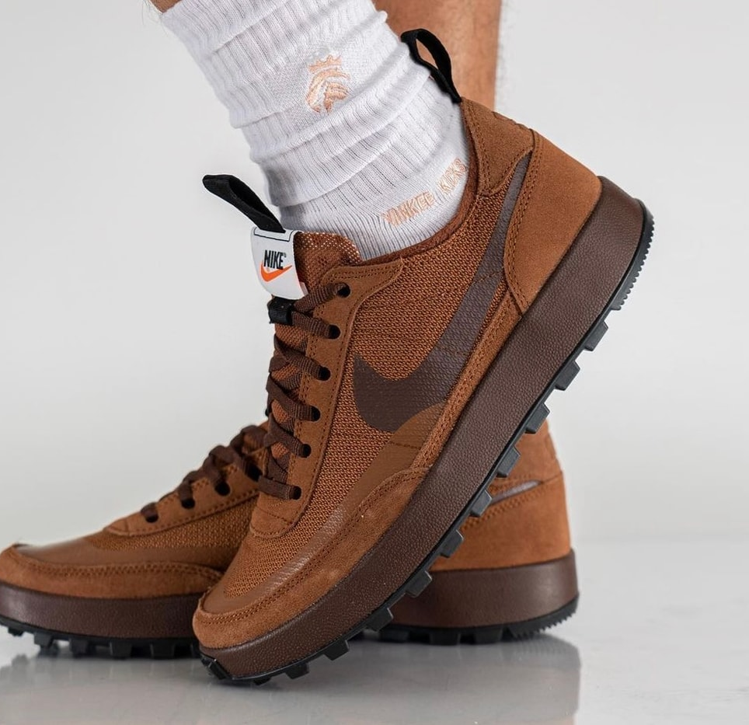
USP
Can your product or service be copied?
What makes your product or service better than competitors?
Toms Shoes:
Every pair of shoes a customer purchases, the company donates a pair to a child in need.
Nike:
Focus primarily on athletic shoes with prominent sponsorships with star athletes..

Slide 5


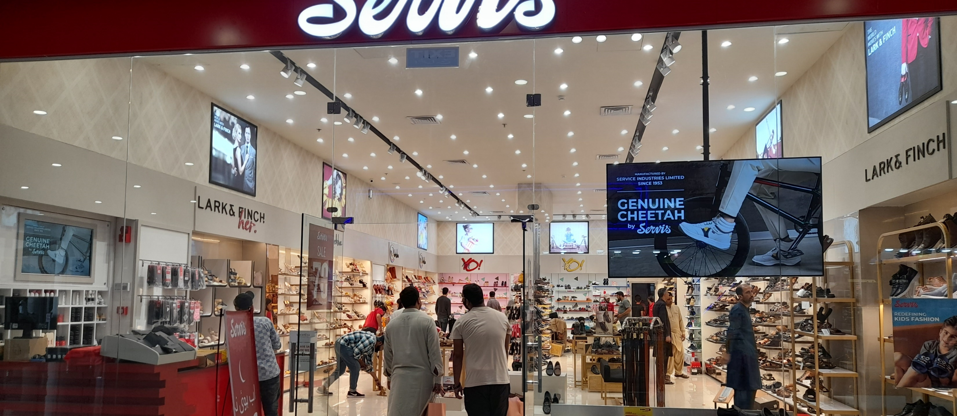


Slide 6
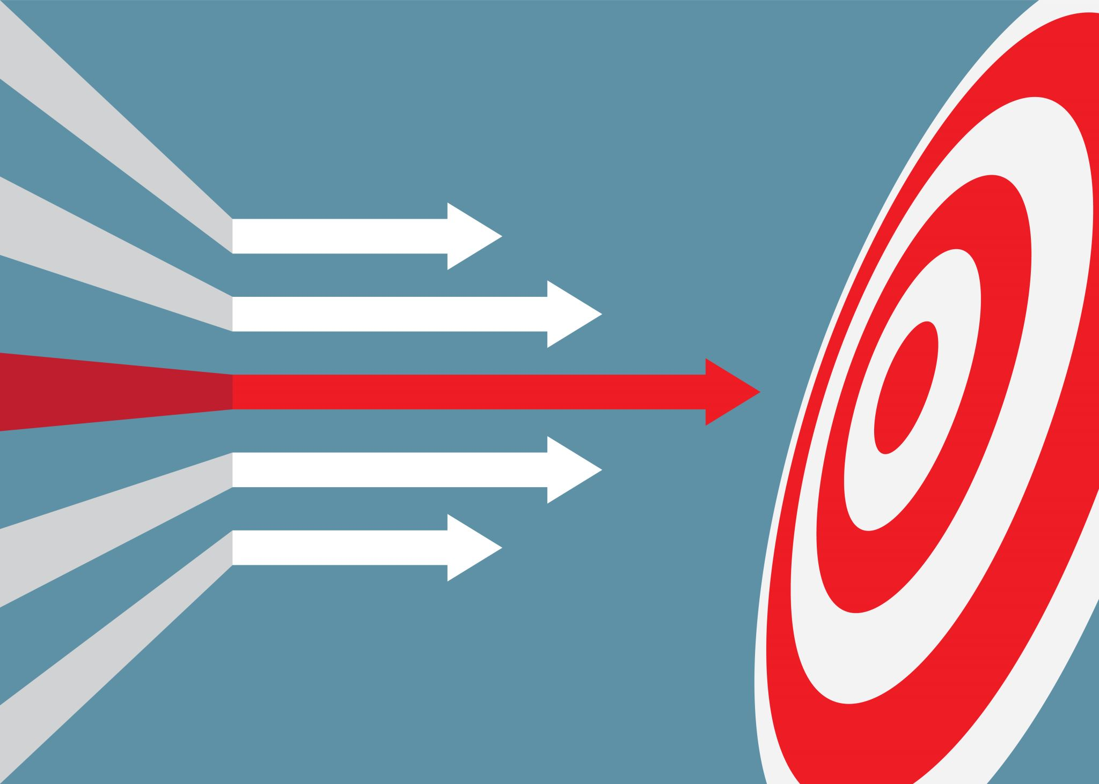
Defining Your Target Market
Who and Where?

Slide 7
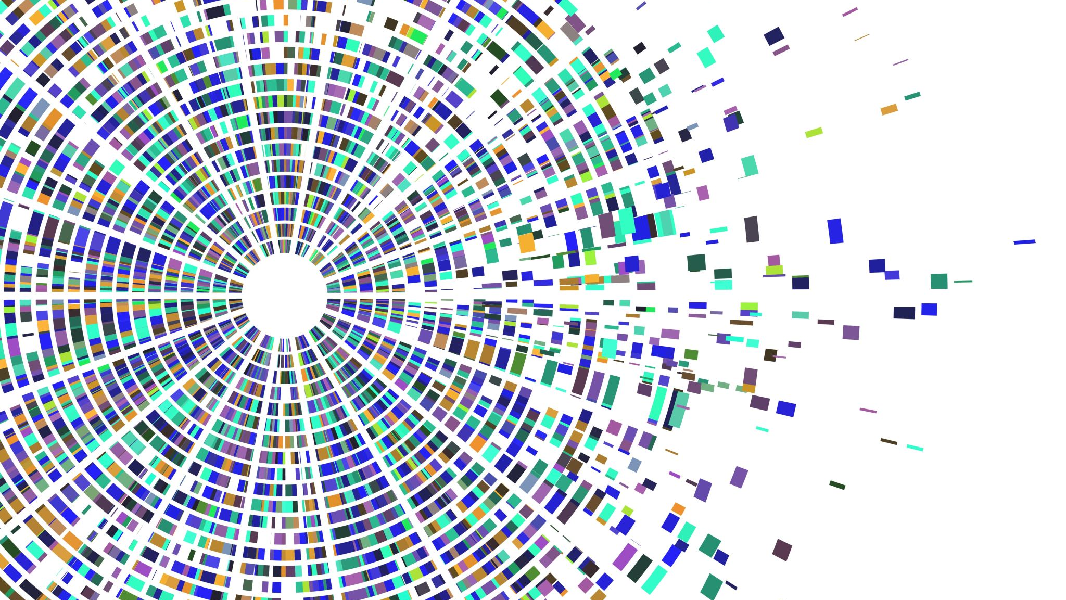
TAM, SAM, SOM
Knowing your potential industry and market

Slide 8
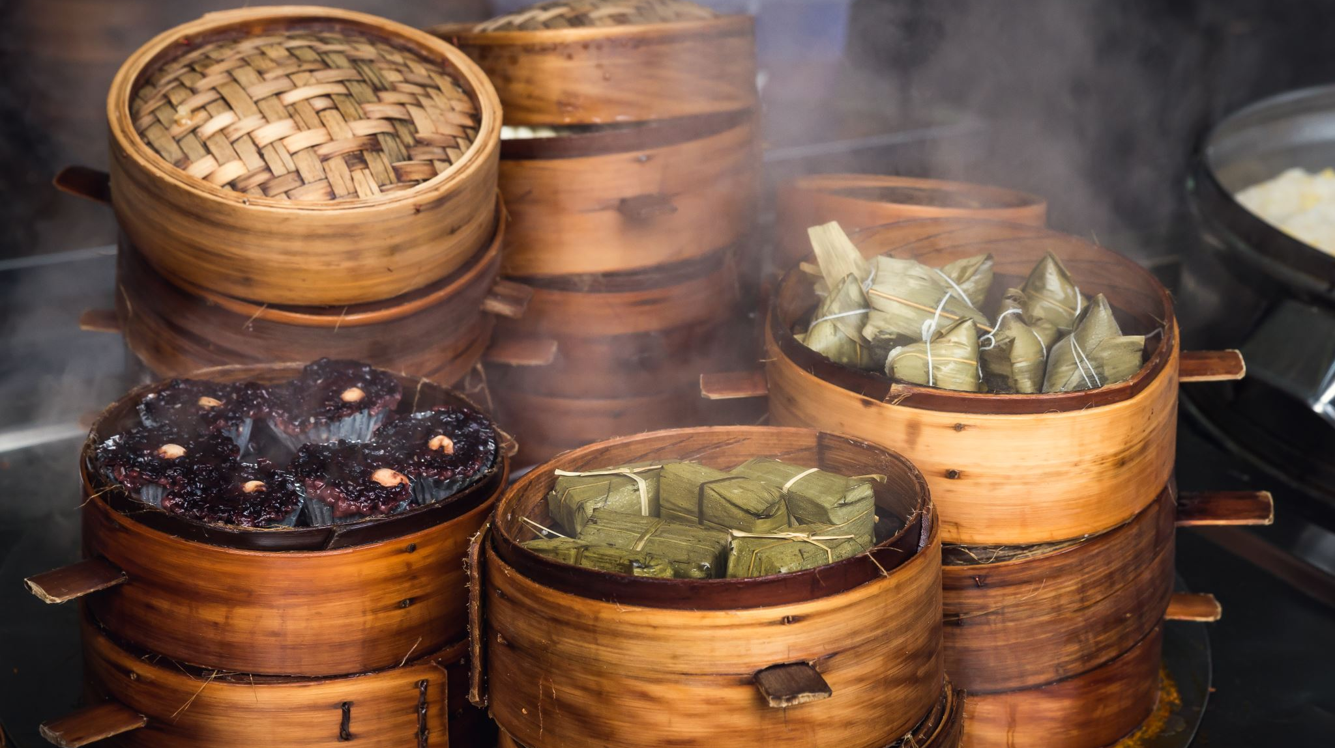
TAM, SAM, SOM
TAM or Total Available Market:
is the total market demand for a product or service.
SAM or Serviceable Available Market
is the segment of the TAM targeted by your products and services which is within your geographical reach.
SOM or Serviceable Obtainable Market
is the portion of SAM that you can capture

Slide 9
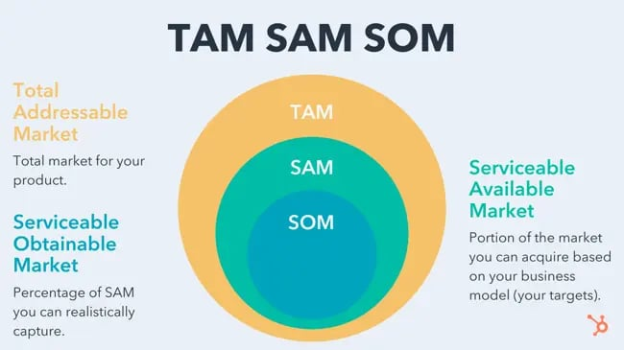

Slide 10

Example – FAST Food Chain / Resturant
USD 750.08 billion globally
TAM
USD 3 billion Fast food market in Pakistan (can go by cities or regions etc.)
SAM
0.02% of SAM in first 3 years = USD 0.6 Million
SOM

Slide 11
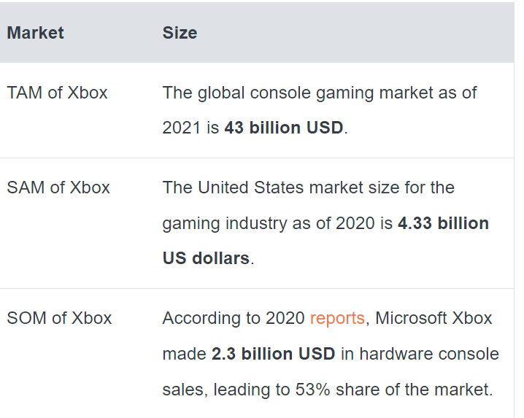
Xbox

Slide 12
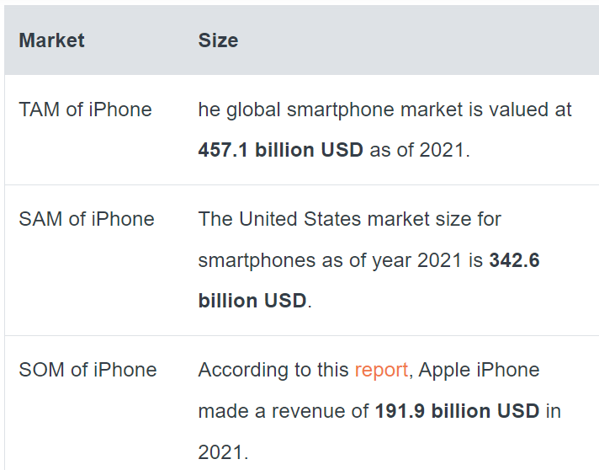
iPhone

Slide 13
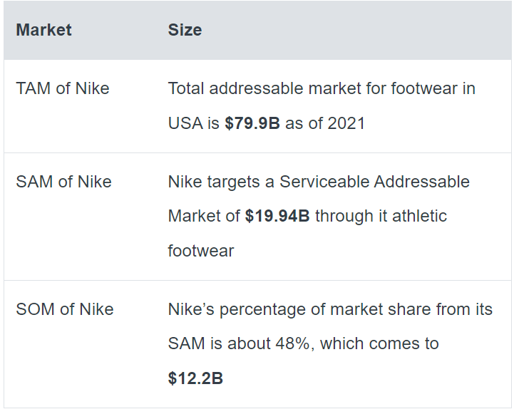
Nike

Slide 14
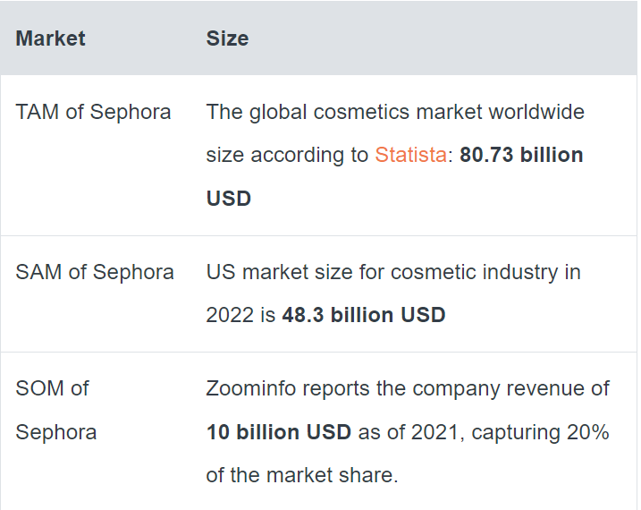
Sephora

Slide 15
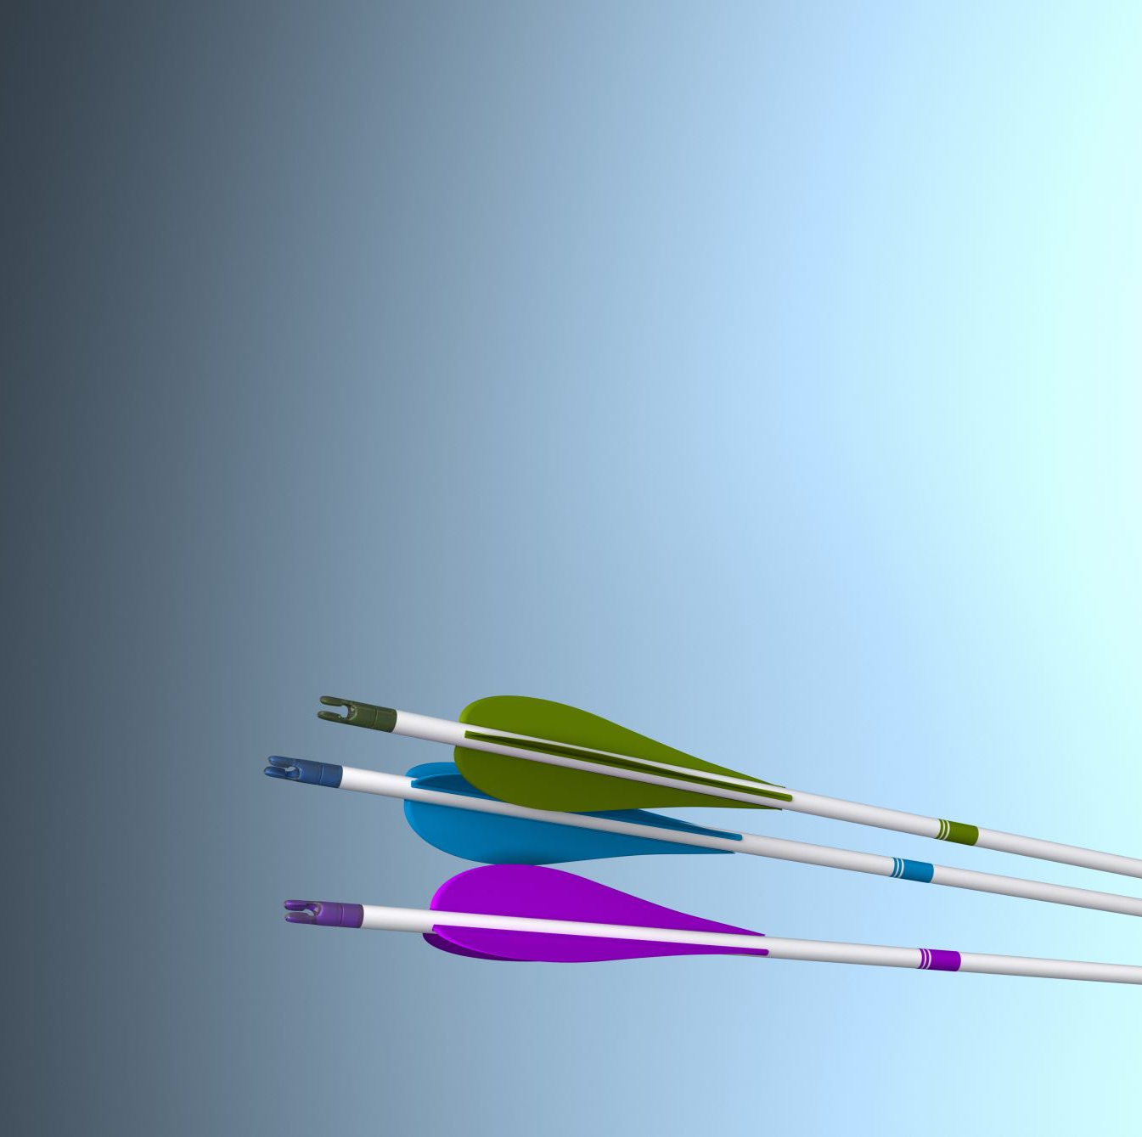
Questions to Answer
Who Is Your Product Or Service For?
What Needs Does Your Product Or Service Meet?
Who Is Most Likely To Buy Your Product Or Service?
What Demographics Are You Targeting?
What Psychographics Are You Targeting?

Slide 16
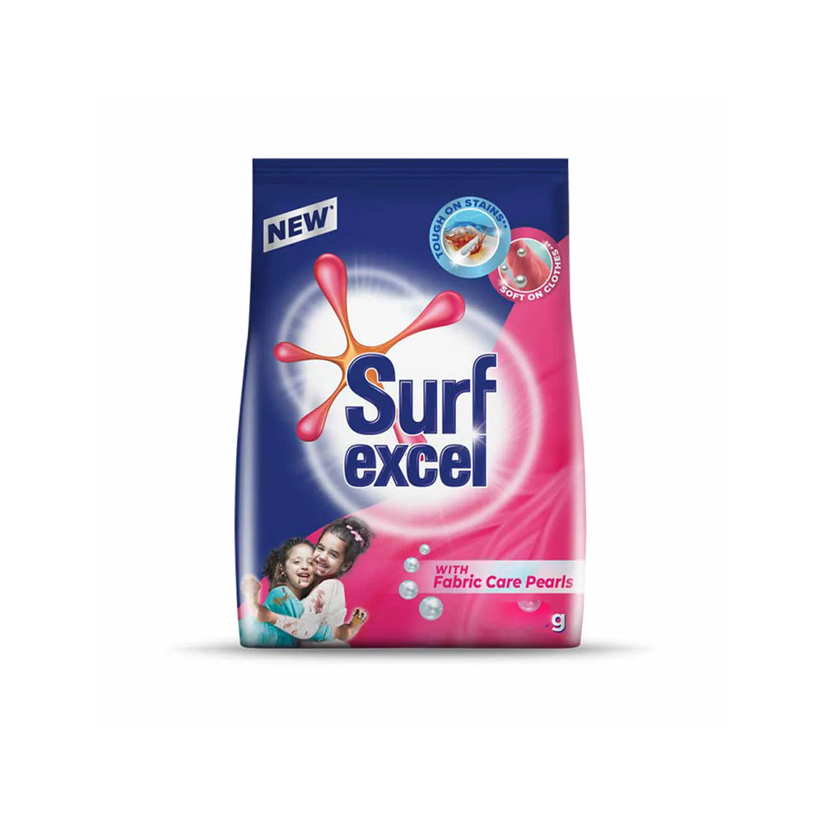
Let's answer them
Who Is Your Product Or Service For?
Group with increase in disposals income Middle class and Upper Class
What Needs Does Your Product Or Service Meet?
Cleanliness / Hygiene
Promoting creativity in Children
Who Is Most Likely To Buy Your Product Or Service?
Woman / Mothers
What Demographics Are You Targeting?
Age: 25 – 50
Gender: Female
Disposable Income : Available
Location: All Over Pakistan
What Psychographics Are You Targeting?
Loyalty
Deliverance of perceived value promised by the product
Quality and Economical.

Slide 17

Why Define Target Market?
Allows You To Focus Your Marketing Efforts
Where to place your ads? TV, Billboards, Social Media
The premium slot during football matches
Helps You Create More Effective Marketing Messages
Who is in your ad / marketing message?
Sana Safinaz Africa Ad Disaster
Allows You To Better Understand Your Customers
What do they want and care about?
Saphire green bags with seeds
Helps You Make Better Product Decisions
Gen Z and Rooh Afza

Slide 18
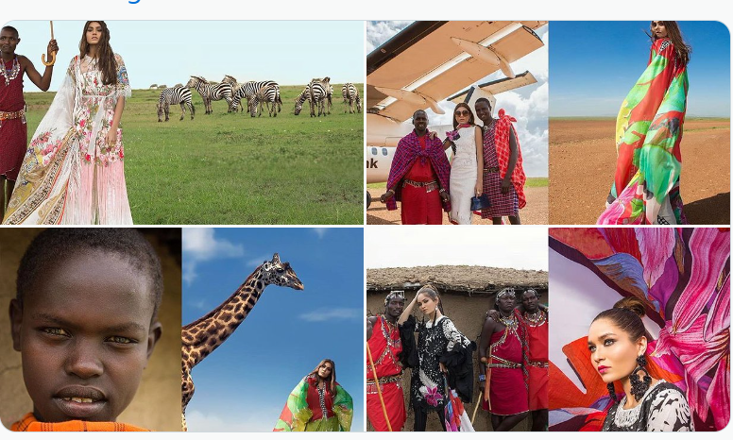

Slide 19

Defining Customer Persona
Fictional /Semi-fictional characters

Slide 20
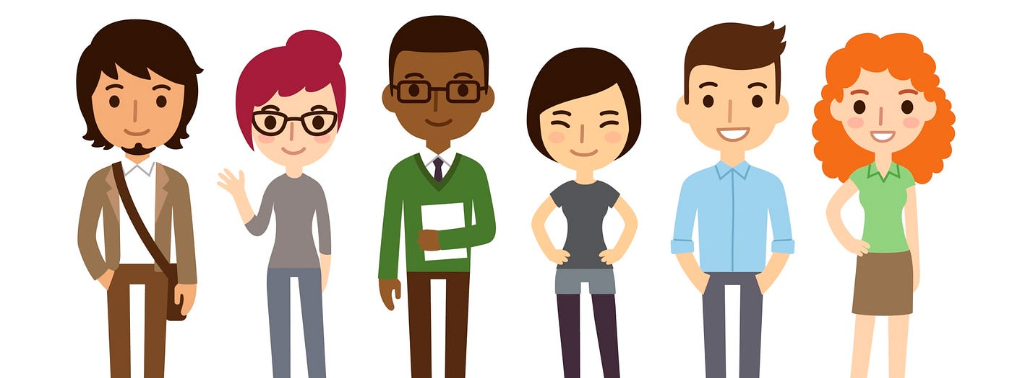
Customer Persona
A persona is a depiction of your ideal customer based on actual data from market research, competitor analysis, and existing customer profiles.

Slide 21

Customer Persona
Fictional or semi-fictional characters that are used to describe and evoke a particular type of customer
Represent a segment of your audience
How?
Give each persona a name, age, job title, hobbies, concerns, values, preferred tech - any criteria that will provide insights into the best marketing tactics and activities to use.

Slide 22
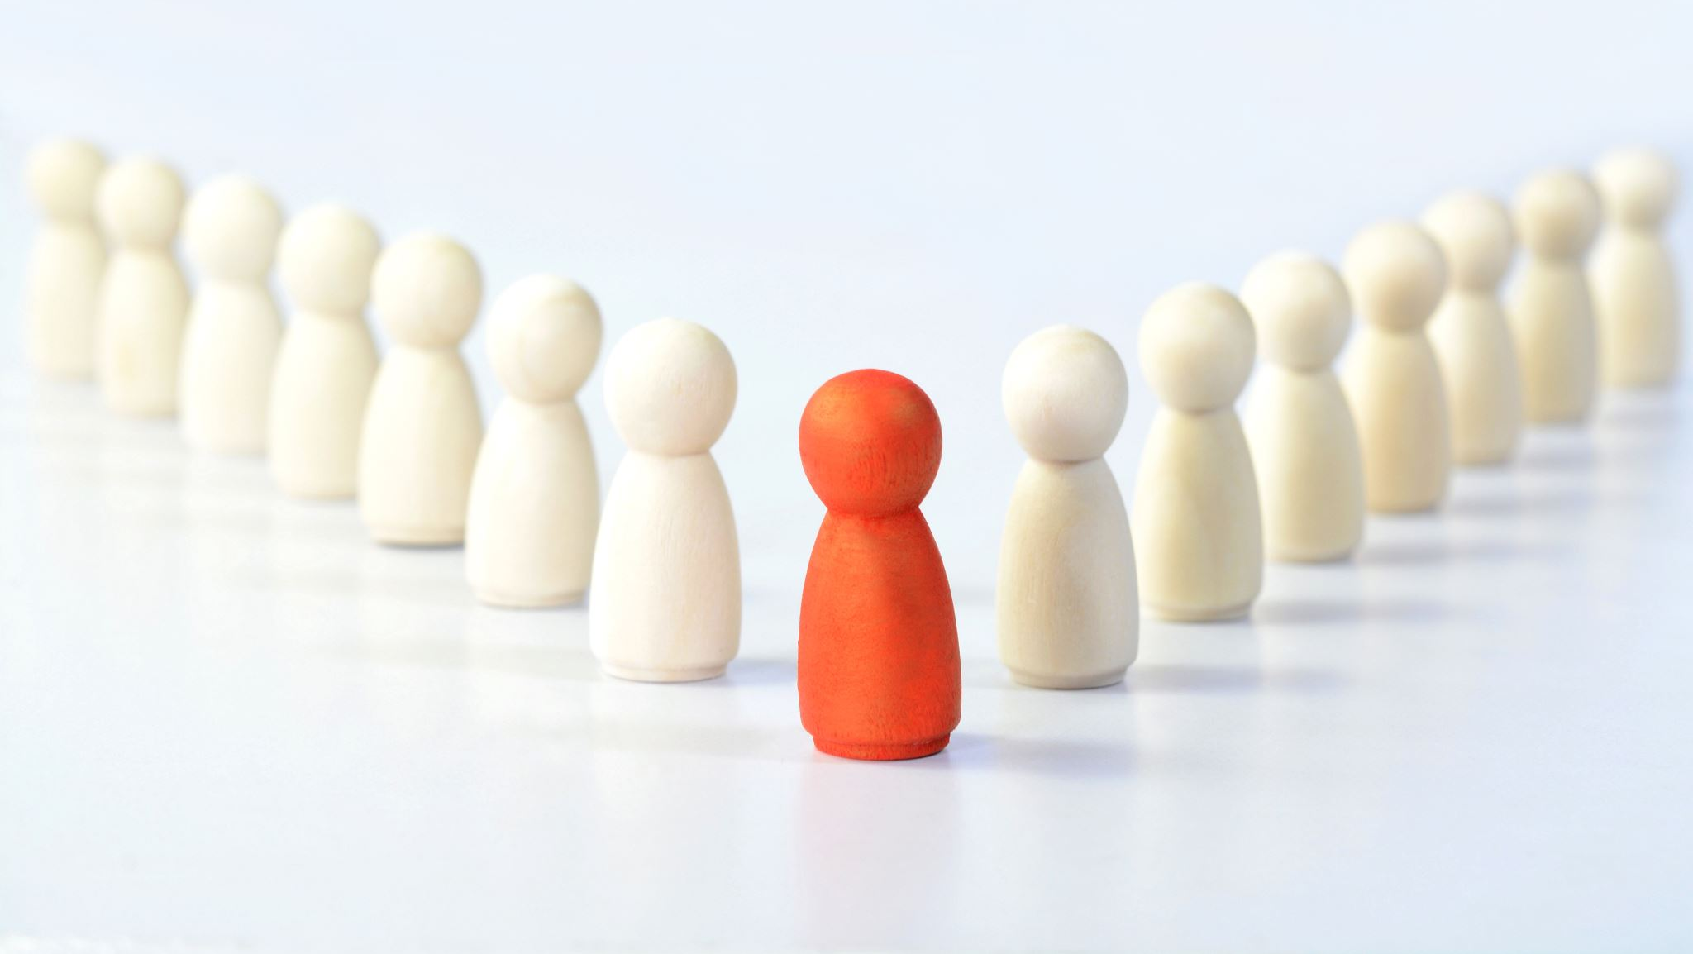
How?
Demographics (the who)
A detailed persona will give you demographic information like age range, gender, income level, location, education, and family status.
Psychographics (the why)
Psychographics focus on the emotional aspect of your buyer, such as their passions, interests, pain points, challenges, motivations, values, and communication preferences.
Behaviour (the what)
Which of your products/services they are interested in and how they came across your solution to the mode of payment used to purchase your product or service.

Slide 23
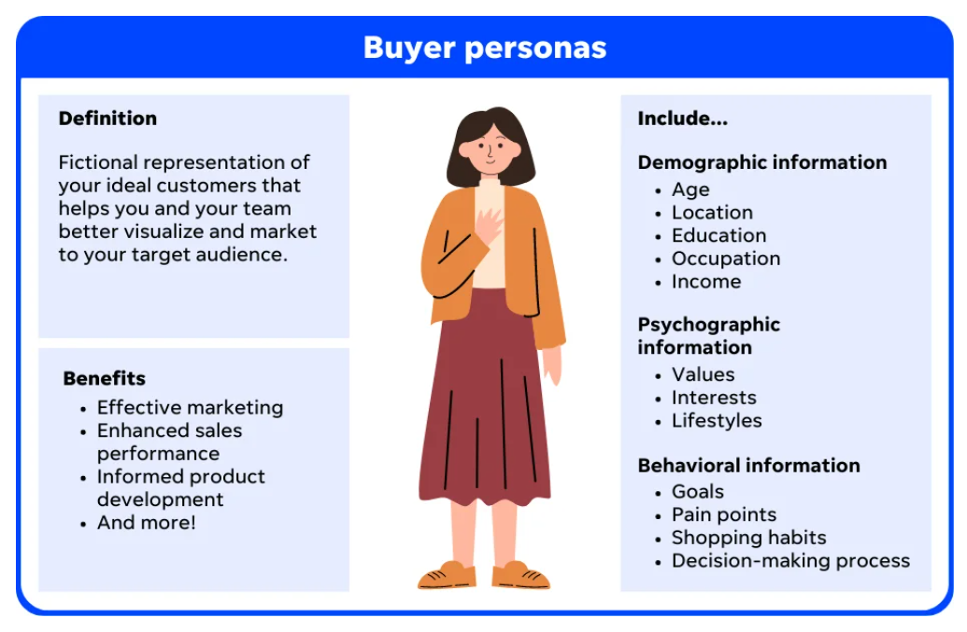

Slide 24
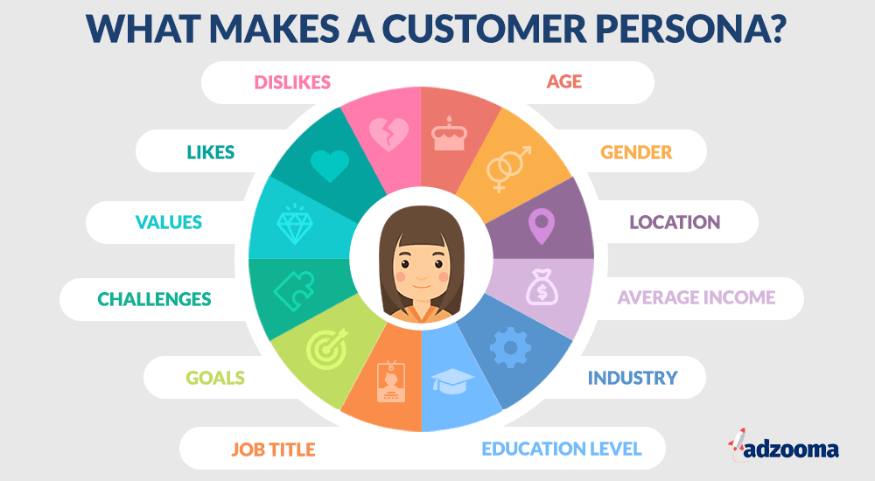

Slide 25
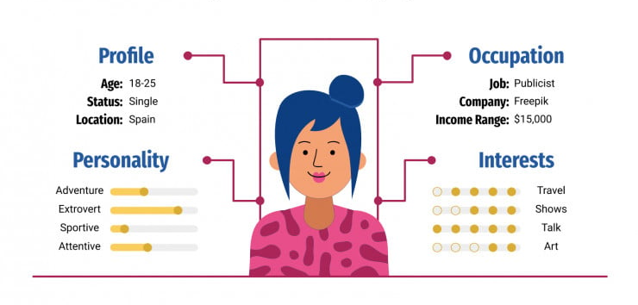

Slide 26
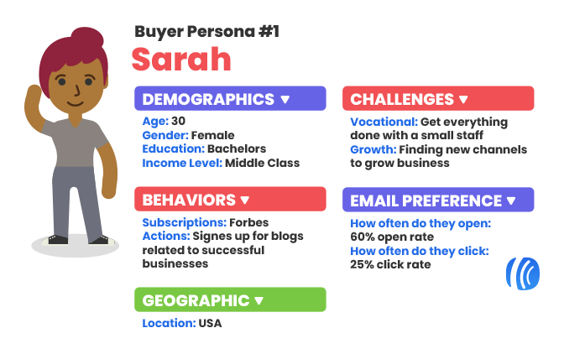

Slide 27
